Slide 1


Slide 2


Slide 3




What you will learn
Explain the concept of state management
Explain the value of state management when developing function components
Describe the syntax of the useState hook
Manipulate a component’s state using the useState hook

Slide 4



States introduction
Manage data that changes
Condition at a specific time
Render accordingly

Slide 5

State management
Enables local state control

Slide 6
Benefits of hooks
Reuse code logic
No need to
Add state management to function components
Change hierarchy
Use nesting

Slide 7
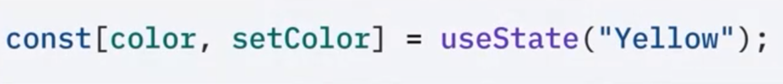
Syntax for useState()
General
Example

Slide 8
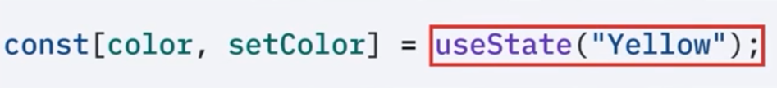
General
Example

Slide 9

General
Example

Slide 10

Array destructuring
Extract array values
Directly assign
Avoids repetitive indexing

Slide 11
stateName variable
Stores current state value
Update as needed

Slide 12
setStateName()
Update state values
Re-renders when called
Triggers UI updates

Slide 13
initialState
Initializes the variables

Slide 14
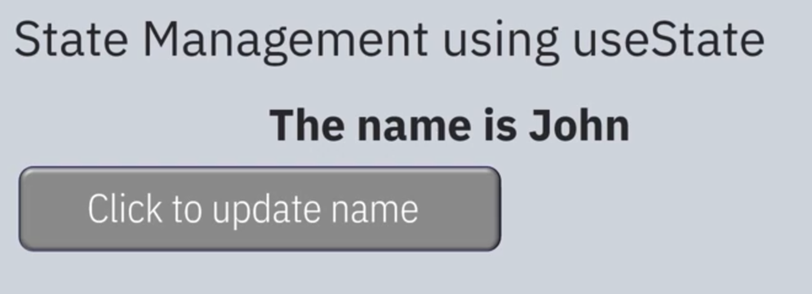
useState example UI

Slide 15
Recap
In this video, you learned that:
State management allows you to manage data that can change over time within a component
The useState hook enables function components to manage the component's state locally
You can use this syntax when using the useState hook:
const [stateName, setStateName] = useState (initialState) ;
Call the "useState" function and pass in the initial state as a parameter
Assign the return value to a const array variable using a destructured array
The array has two values: the state name and the state name prefixed with the keyword "set"
You should use the useState hook when you need to make a component dynamic and interactive

